Slide 1
Lecture 10
NFT Digital Twins and Data Storage

Slide 2
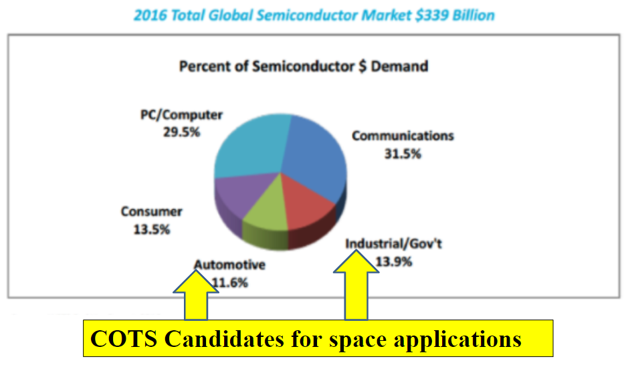
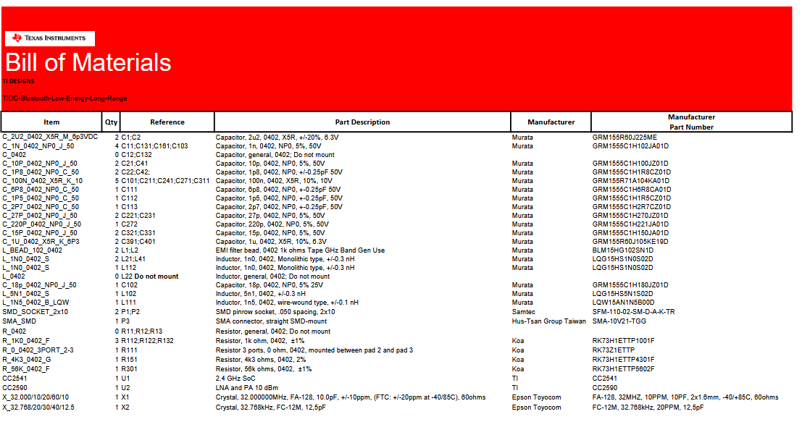
Challenge 1 - Space procures in small, custom quantities
- COTS components for space makes up for <0.1% demand of the semiconductor market.
- For COTS manufacturers, the quantity is too insignificant for direct sales. Redirect space component procurers to distributors.
- For custom space component manufacturers, no incentive for any storage of wafers given the extremely low and infrequent orders, requiring a reactive sourcing and increasing duration of production.
- These conditions make space customers extremely unattractive for many manufacturers. Some explicitly do not deal with space buyers.
- Other manufacturers impose a Minimum Order Quantity (MOQ) or a penalty if the order falls below that.

Slide 3




Solution - Demand aggregation
A larger company often acts as a "project manager" for smaller companies who require Space components.The orders are then aggregated together into a larger BOM (Bill of Materials).
A further step of consolidation is performed by the central procurer called "parts standardization". The project manager tries to reduce the number of different components on the BOM by combining similarly performing components together and increasing the quantity of individual components and reducing the number of line items.
It is also advisable to group together parts testing. Testing incurs a significant cost in its setup, eg. radiation test chambers, and per unit testing fee. Some tests destroy the component so having larger batches and similar test groups is crucial in reducing cost and time of manufacture.
PCB - Parts Control Board
JD - Justification Document
PCN - Parts Change Notice
SAP for order tracking
Third party design studios or test houses for additional needs

Slide 4
Blockchain driven improvement
Potential:
Blockchain have the ability to allow anyone to participate. More space companies mean better pooling capabilities.
It is also possible to pool financial resources for testing or acquisition of custom components. Smart contracts may list campaigns and execute automatically when conditions are met. Eg. Component type, tests to be performed and target financing reached.
Hinderance:
How to vet growing number of participants?
Possibility of IP leaks when sharing BOMs?

Slide 5
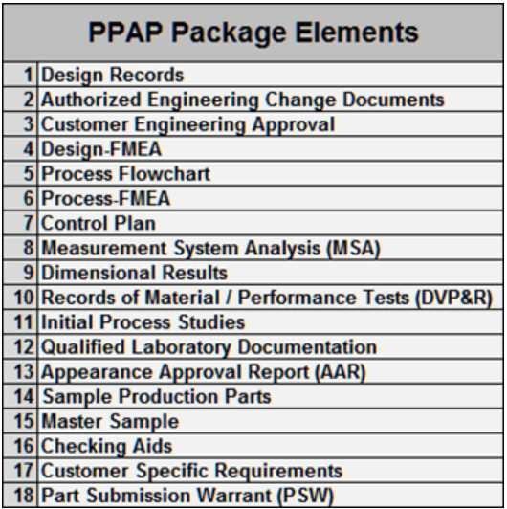
Challenge 2 - Documentation scarcity
- COTS components for space makes up for <0.1% demand of the semiconductor market. As is in Challenge 1, difficult to gain manufacturer information and cooperation.
- Space agencies cannot acquire any data about the component. Only what is available publicly.
- Only Automotive, Healthcare and Governmental COTS have established certifications like AEC-Q, JEDEC, providing any reliability indicators.
- No connection to the automotive industry to ask for PPAP.
- EEE components designated for commercial use does not need radiation testing.
- Space agencies cannot obligate manufacturers to perform specific tests or inspect the manufacturing process on site.

Slide 6
Solution - EEE-component database in comparison
 | PMPedia | ESARAD | ALTER DoEET
Administrator | University of Colorado | ESA | ALTER Technologies
Purpose | Offer COTS alternatives Encourage knowledge sharing | Provide high quality radiation data | Increase revenue of components and services
Accessibility | Public | Admin approval | DoEET Client
# of Components | 775 (COTS only) | 314 (HiRel + COTS) | 44,878 (HiRel + COTS)
Data Source | Mostly US True open source | European limited | International
Data Quality | Unmaintained, lack manpower | Detailed report Aged data (10+ years) | Extensive, but mostly alerts, few radiation reports
Features & Functionality | Expert led forum API Comparator | Request to test pilot | Crowdfunded testing BOM creation Comparator

Slide 7
Blockchain driven improvement
Potential:
Allow more contributors of data. Especially from SMEs offering innovative components.
Aggregate all data sources into one platform, across geographical boundaries.
Community maintenance and reporting on available data.
Hinderance:
How is data quality controlled?
Legalities of open sourcing component data? Liability of usage?
Trust between participants

Slide 8
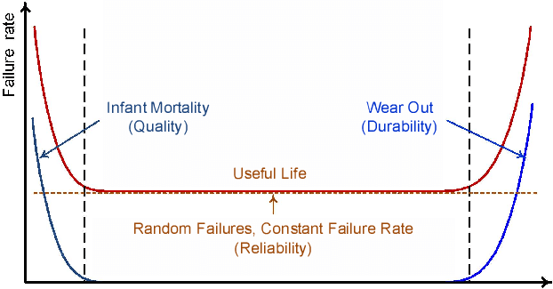
Challenge 3 - Mass production vs Controlled customization
Production
Testing
- Mass produced components mix wafers.
- Wafer level radiation testing absent.
- Date / Lot code only created at a later point
- Different companies have no unique identifiers. This implies that manufacturers can produce lots with the exact same trace code.
- Small components don't have trace codes lasered on. Paper documentation vulnerable to loss.
- More complex components made from base components in different lots
- Distributors may further mix lots.
Even with documentation, commercial components follow different philosophies of reliability. For mass produced components, focus is on zero defect. This is achieved by SPC during production and testing to eliminating infant mortals and accidental failures.

Slide 9
Solution to production
Purchase full reels to increase lot homogeneity.
Smaller manufacturers may be open to customisations or increased traceability by establishing a UUID for a line.
Use only Authorized Distributors! This may be difficult in times of market crisis. Eg. The semiconductor crisis during Covid.
Some space companies rely on "intuition" based on a long standing relationship with the manufacturer.
NASA attempted to create preferred manufacturers and established COTS lists but very few manufacturers are listed: https://nepp.nasa.gov/pages/ilpm/establishedparts.cfm

Slide 10
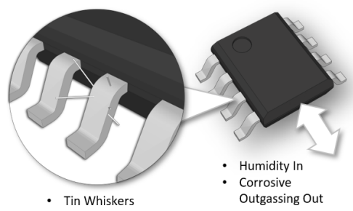
Further challenges of testing
Testing costs a huge amount of money. There is a Non-Recurring Charge for set up of the testing environment and a per unit recurring charge. Sometimes it is cheaper the buy space grade components than perform testing on COTS.
With decreased lot homogeneity of COTS, more samples are required per lot for destructive and non-destructive analysis.
With these kinds of expenses, New Space companies are all looking for the cheap COTS alternative that performs sufficiently. Hence, test data is guarded closely under NDA.
Automotive components are designed for road use.
- Lead is prohibited for consumer use but in space pure tin grows "whiskers".
- Other space conditions like outgassing and radiation.
- Temperature tests have smaller range.
Qualifications like AEC-Q and JEDEC allows exemptions from testing!

Slide 11
Solution to testing
Some efforts to share testing data like R2COTS where testing data may be sold.
What if we just don't do any testing?
COTS are cheap. Use redundant systems in satellites and switch over to backup once failure is detected. Wasteful, but in LEO and NEO, environmental conditions like temperature and radiation not as severe. Mostly works.
Manufacturers like Infineon are beginning to offer radiation tolerant COTS or "enhanced COTS "as an in between product.
Model-based systems engineering (MBSE) can simulate environments and reduce the burden of some tests. Not completely replace, but offer design alternatives and assess radiation response.

Slide 12
Blockchain driven improvement
Potential:
Rewards for adding testing data to the platform
Allowing data owners control over different levels of privacy for their data
Possible different incentives for publishing data - per access, one off charge, etc.
Hinderance:
How to ensure SMEs can compete with larger corporations?
Need a significant participation for robust market forces.

Slide 13
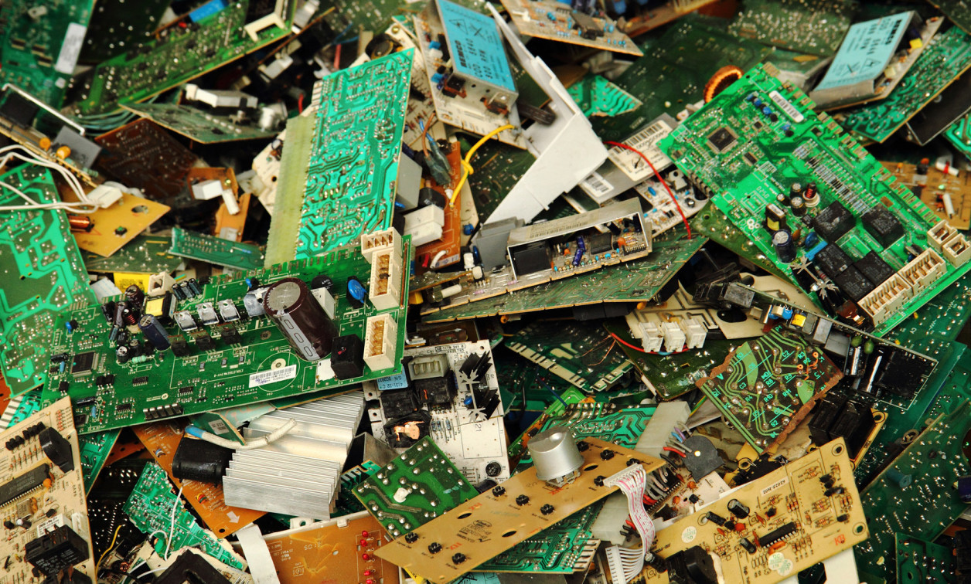

Challenge 4 - Fast obsolescence of COTS
Obsolescence
- COTS have a 2 - 3 year life expectancy. A space mission has 10 - 15 years schedule.
- Part unavailable while still under construction?
- Huge amount of waste produced. Reuse can save millions.
- Inability to build component heritage
Documenting change
- A lot of alerts and change notices are generated.
- Space standards requires documentation of all changes and approval for these changes.
- Would make missions impossibly long to discuss all changes. Part is likely to be obsolete soon anyways.
- On a Blockchain: garbage data?

Slide 14
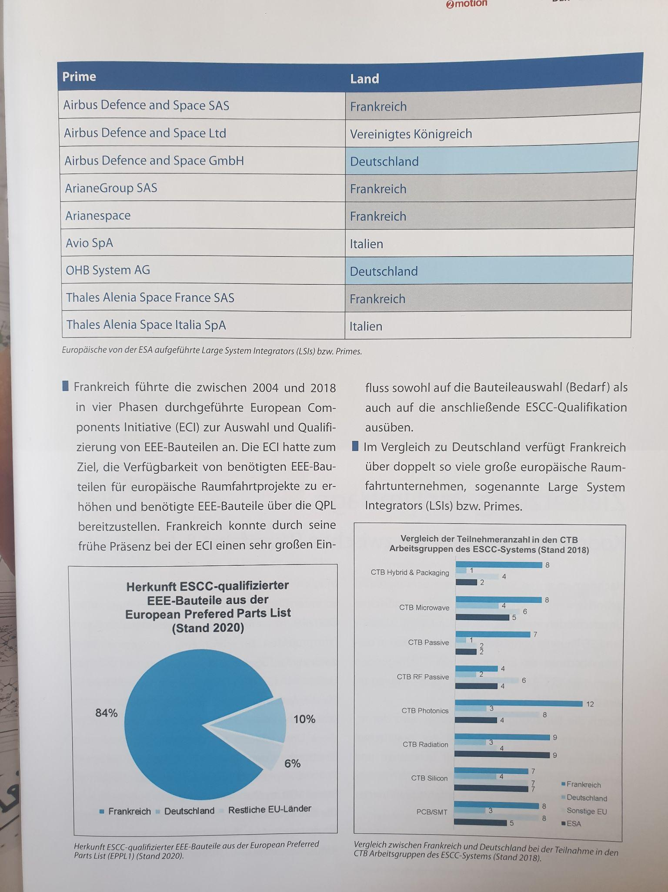
Challenge 5 - Space market inequalities
US produced components used to make up of 80% of a mission, after a few billion euros subsidy now at just below 50%. Foreign dependence subject to ITAR and EAR regulation and political changes.
In the EU, France dominates COTS for space suppliers. Why? The role and history of the agency has an impact.
France has tightly integrated and highly developed Air and Defense sectors. CNES, created under Charles de Gaulle, connects with many ministries and has great diversification of use cases. In comparison, DLR focused on space research and has difficulties collaborating with the developed automotive sector in Germany.

Slide 15
NFT Architecture
Notes:
Every device we have today is a turing machine and Ethereum operates on similar principles

Slide 16
NFT Standards explosion
Manipulating Fungibility
Marketplace
Use Case
ERC-1155: Multi Token Standard
ERC-3525: Semi-Fungible Token
ERC-2309: ERC-721 Consecutive Transfer Extension
ERC-6066: Signature Validation Method for NFTs (Access Verification)
ERC-2981: NFT Royalty Standard
ERC-4955: Vendor Metadata Extension for NFTs (3D models)
ERC-721: Non-Fungible Token Standard
ERC-4910: Royalty Bearing NFTs
ERC-4519: Non-Fungible Tokens Tied to Physical Assets (IOT)
Rental and Services
ERC-4907: Rental NFT, an Extension of EIP-721
ERC-5007: Time NFT, ERC-721 Time Extension

Slide 17
The ERC721 Standard
function name() public view returns (string)
function symbol() public view returns (string)
https://eips.ethereum.org/EIPS/eip-721
function balanceOf(address _owner) external view returns (uint256);
function ownerOf(uint256 _tokenId) external view returns (address);
function safeTransferFrom(address _from, address _to, uint256 _tokenId, bytes data) external payable;
function safeTransferFrom(address _from, address _to, uint256 _tokenId) external payable;
function approve(address _approved, uint256 _tokenId) external payable;
function setApprovalForAll(address _operator, bool _approved) external;
function getApproved(uint256 _tokenId) external view returns (address);
function isApprovedForAll(address _owner, address _operator) external view returns (bool);
event Transfer(address indexed _from, address indexed _to, uint256 indexed _tokenId);
event Approval(address indexed _owner, address indexed _approved, uint256 indexed _tokenId);
event ApprovalForAll(address indexed _owner, address indexed _operator, bool _approved);
Notes:
In 2016, first way to allow smart contracts accept tokens from a wallet. They then do something with the tokens, that's why they are called spenders.
Allowance checks how much a wallet can approve.

Slide 18
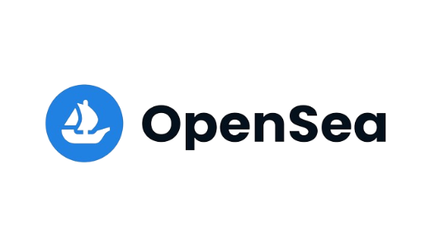
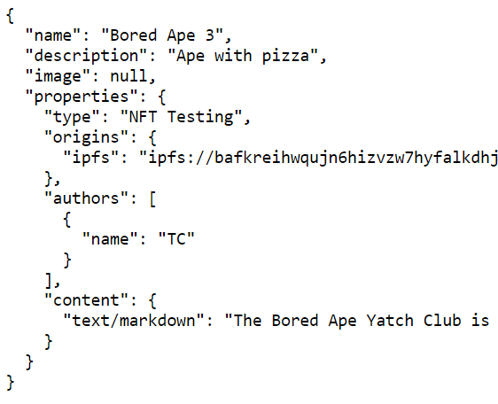



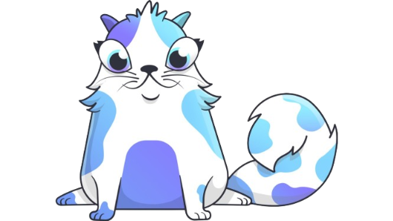

NFT Architecture - A visual
Metadata
Must be raw!
Frontend
Onchain?
IPFS?
HTTPS?
_setTokenURI()

Slide 19
NFT Storage
Notes:
Every device we have today is a turing machine and Ethereum operates on similar principles

Slide 20
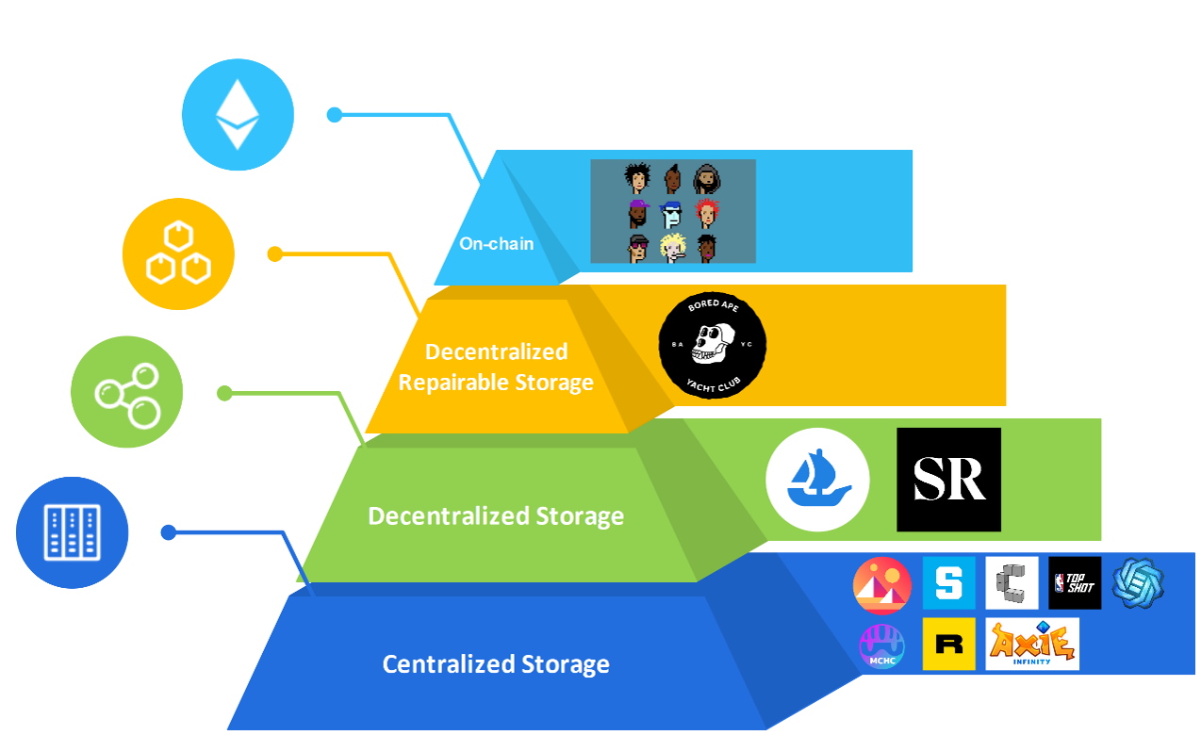
Storage Types
Notes:
https://group.hashkey.com/en/insights/key-infrastructure-of-the-metaverse-status-opportunities-and-challenges-of-nft-data-storage

Slide 21
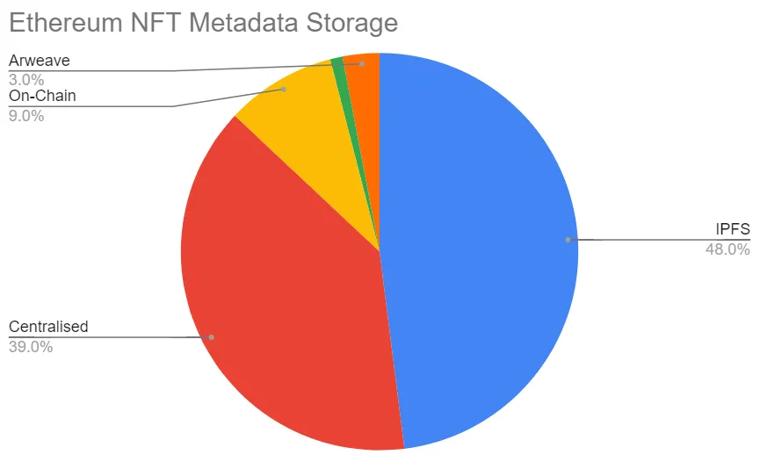
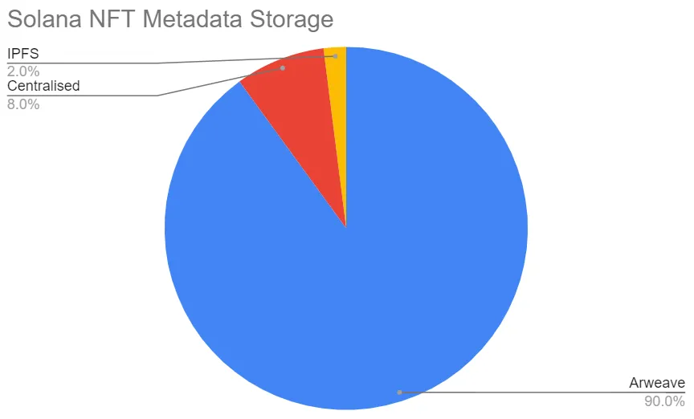
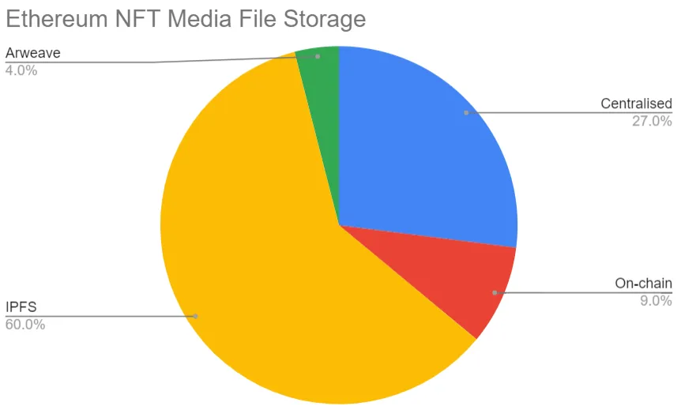
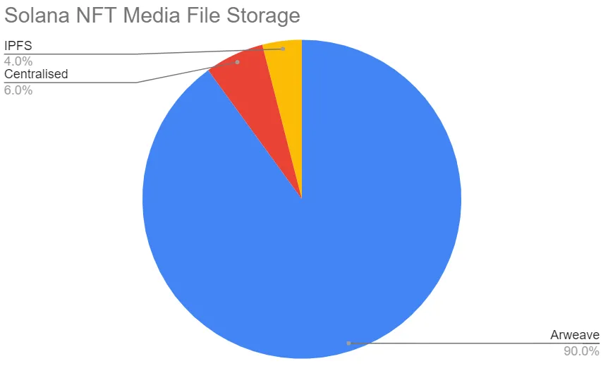
Storage Comparison

Slide 22
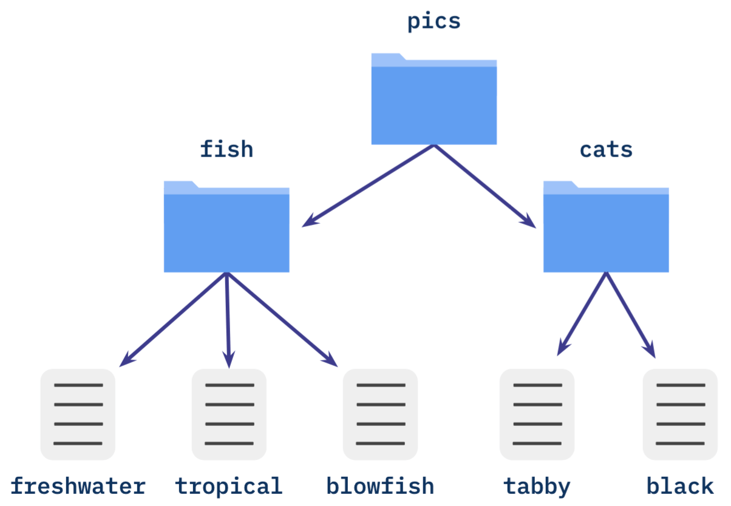
IPFS - Directed Acyclic Graphs (DAG)
Directed - Has definite direction / path
Acyclic - No circles, all paths are unique
Graph - Tree like data structure
Merkle Trees are hashed trees: CIDs!!

Slide 23
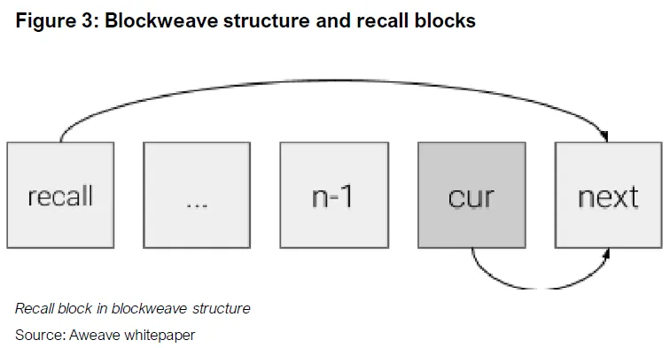
Arweave - Permanent Data Storage
Users pay miners a once off fee
Miners choose what information to incorporate.
Proof of Access + blockhash list to prevent downloading entire ledger

Slide 24
NFT as Digital Twins

Slide 25
Digital Twin - Definition
A digital twin is a digital replica of a physical object, person, system, or process, contextualized in a digital version of its environment. Digital twins can help many kinds of organizations simulate real situations and their outcomes, ultimately allowing them to make better decisions.
McKinsey, 2024

Slide 26
NFT Digital Twin for Space
Design the NFT
Which EIP? Does the EIP function fit purpose?
Custom functions?
Onchain vs Offchain data storage
Decide on the ledger
Space is a high trust industry, but we want collaboration
Permissioned / Permissionless / Consortium / Hybrid
What is the Tokenomics?
Your NFT should address at least one of the challenges discussed in class today
Keep it realistic - these are complex issues, even a small improvement is success.

